Slide 1
Basics of ADO.Net
Ado.net is used to connect with different data source. It provides interoperability and scalable data access by XML
October 4, 2016

Slide 2
Agenda
What is ADO.NET?
Data Provider
ADO.Net Objects
Connection to an ADO.NET database
Display data in a DataGrid
Data relationship between two tables
DataBindings for TextBoxes
Exercise

Slide 3
What is ADO.Net

Slide 4
What is ADO.NET?
ADO.NET provides a bridge between the front end controls and the back end database.
The strength of ADO.NET is firstly that it lets applications access various types of data using the same methodology.
ADO.NET is a set of classes that comes with the Microsoft .NET framework to facilitate data access from managed languages.
The ADO.NET classes are found in System.Data.dll and are integrated with the XML classes in System.Xml.dll.
ADO.NET provides two models for data access: a connected model where I can keep the connection with the database and perform data access, and another way is to get all the data in ADO.NET objects that let us perform data access on disconnected objects.

Slide 5
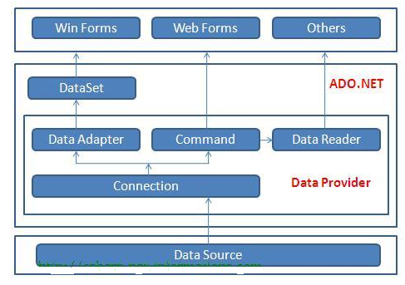
What is ADO.NET?

Slide 6
Data Provider

Slide 7
Data Provider
You can use ADO.NET to access data by using the new .NET Framework data providers which are:
Data Provider for SQL Server (System.Data.SqlClient).
Data Provider for OLEDB (System.Data.OleDb).
Data Provider for ODBC (System.Data.Odbc).
Data Provider for Oracle (System.Data.OracleClient).

Slide 8
ADO.Net Objects

Slide 9
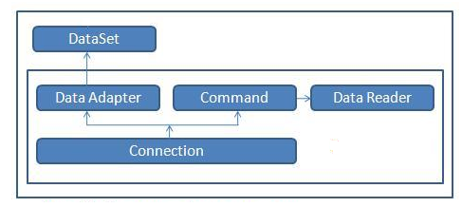
ADO.Net Objects

Slide 10
ADO.Net Objects - DataSet
DataSet
It persists data in memory which is separately from the database.
By nature it is disconnected.
You can perform all DML statement.
You can load data in dataset from any data source like SQL Server, Oracle etc.
You can create table inside the Dataset even you can define the keys and create relationship between them.
It belongs to “System.Data” namespace.

Slide 11
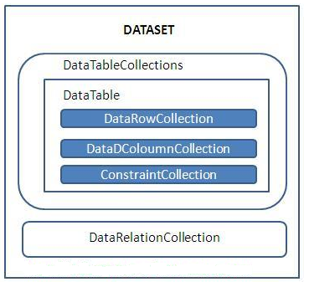
ADO.Net Objects – DataSet
Using system.Data; DataSet objDS = new DataSet();
objDS.DataSetName = "EmployeeDS";
OR
DataSet objDS = new DataSet("EmployeeDS");

Slide 12
ADO.Net Objects - Data Adapter
Data Adapter
It is used to fill the dataset and send the update to the database server.
It is used to fetch and retrieve the data.
It holds the data in memory than pass it to Dataset.
It is used for write and read purpose.

Slide 13
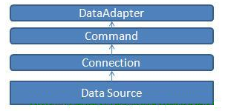
ADO.Net Objects – Data Adapter
SqlDataAdapter DA = new SqlDataAdapter(cmd);
DataSet ds = new DataSet();
DA.Fill(ds);

Slide 14
ADO.Net Objects – Command
With the help of this command you can communicate with the database.
You can directly pass the query or you can use “Stroed Procedure”.
With the help of command type (Text, Stored Procedure, DirectTable) you can choose whether you are going to use plain SQL Query or Stored Procedure.

Slide 15
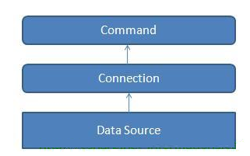
ADO.Net Objects – Command
SqlCommand cmd = con.CreateCommand();
cmd.CommandType = CommandType.Text; //This will specify that we are passing query from application
string query = "select * from Authors";
cmd.CommandText = query;
OR
SqlCommand cmd = con.CreateCommand(); // This will specify that we are passing the stored procedures name
cmd.CommandType = CommandType.StoredProcedure;
cmd.CommandText = CommandName; // This will be the stored procedures name
SqlParameter param = new SqlParameter("@id", txtSearch.Text);
cmd.Parameters.Add(param);

Slide 16
ADO.Net Objects – Connection
The Connection Object is Handling the part of physical communication between the .Net application and the Data Source.
When the connection is established, SQL Commands will execute with the help of the Connection Object and retrieve or manipulate data in the Data Source.
SqlConnection objCon = newSqlConnection
(ConfigurationManager.AppSettings["connectionstring"].ToString());
Above line reads the connection string settings from web config and will return the connection object in objCon
You can define your connection string setting in Web.config as
<appSettings> <addkey="strConnect"value="Data Source=Dell-PC\SQLEXPRESS; initial catalog=TestDB;Integrated Security =True;"/> </appSettings>

Slide 17
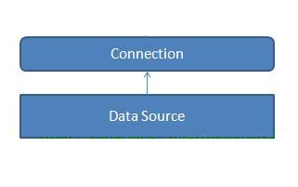
ADO.Net Objects – Connection

Slide 18
Display data in a DataGrid

Slide 19
Display data in a DataGrid
The DataGrid control for displaying either a single table or the hierarchical relationships between a set of tables. If you want to work with the DataGrid control, DataGrid should be bound to a data source by using:
the DataSource and DataMember properties at design time or
the SetDataBinding method at run time.

Slide 20
Display data in a DataGrid
this.dataGrid1 DataSource = datc.dSet.Tables["Per
sonTable"];
You can only show one table in the DataGrid at a time.
this.dataGrid1.SetDataBinding(dset,"customers");

Slide 21
Data relationship between two tables

Slide 22
Data relationship between two tables
If you define a parent-child relationship between tables, you can navigate between the related tables to select the table you want to display in the DataGrid control.

Slide 23
Data relationship between two tables
DataSet dset=new DataSet();
string strCustomers="select * from customers";
string strOrders="select * from orders";
SqlConnection sqlcon=new SqlConnection(“data source=SONY\\MYSQLSERVER;initial" + " catalog=Northwind;integrated security=SSPI;");
SqlDataAdapter dadapter=new SqlDataAdapter(strCustomers,sqlcon);
dadapter.Fill(dset,"Customers");
dadapter=new SqlDataAdapter(strOrders,sqlcon);
dadapter.Fill(dset,"Orders"); // Add the relation to the
DataSet. dset.Relations.Add("Customer Orders", dset.Tables["Customers"].Columns["CustomerID"], dset.Tables["Orders"].Columns["CustomerID"]);
//Display data in the DataGrid
//both works fine
this.dataGrid1.DataSource=dset.Tables["Customers"];

Slide 24
DataBindings for TextBoxes

Slide 25
DataBindings for TextBoxes
DataBinding is the ability to bind some elements of a data source with some graphical elements of an application.
Windows Forms Controls support two types of data binding:
Simple Data Binding
Complex Data Binding

Slide 26
DataBindings for TextBoxes
// Simple DataBinding for TextBox "textBox1" textBox1.DataBindings.Add("Text", dataset, "studentTable.studentID");
//Complex Databinding for Grid
datagrid1.DataSource = dSet; // Use the DataMember property to specify the DataTable. datagrid1.DataMember = "PersonTable";

Slide 27

Thank You!
Salil Belapurkar
Technical Lead
Mobile: +919850042013
Desk: 6398
Salil.belapurkar@xoriant.com
www.xoriant.com
India
Mumbai
4th Floor, Nomura
Powai , Mumbai 400 076
Pune
5th Floor, Amar Paradigm
Baner, Pune 411 045
Kolkata
2B, 12th Floor, Tower ‘C’
Rajarhat, Kolkata 700 156
US – Corporate Headquarters
1248 Reamwood Avenue,
Sunnyvale, CA 94089
Phone: (408) 743 4400
343 Thornall St 720
Edison, NJ 08837
Phone: (732) 395 6900
UK
20 Broadwick Street
Soho, London
W1F 8HT, UK
89 Worship Street
Shoreditch,
London EC2A 2BF, UK
Phone: (44) 2079 938 955
Bangalore
4th Floor, Kabra Excelsior,
80 Feet Main Road, Koramangala 1st Block,
Bengaluru (Bangalore) 560034
Gurgaon
A/373rd Floor, Sigma Center
Gurgaon, Haryana 122 011s

